Slide 1

INTRODUCTION TO AI/ML
-Jeff Nieman

Slide 2
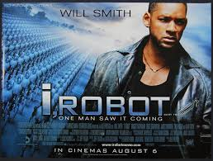
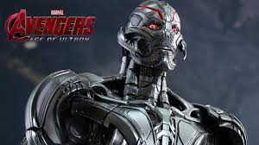

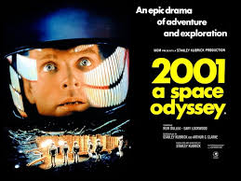
Welcome to Science Fiction
What do you think is artificial intelligence or machine learning?

Slide 3
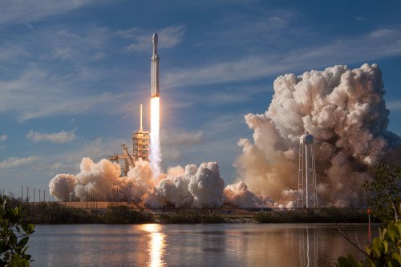


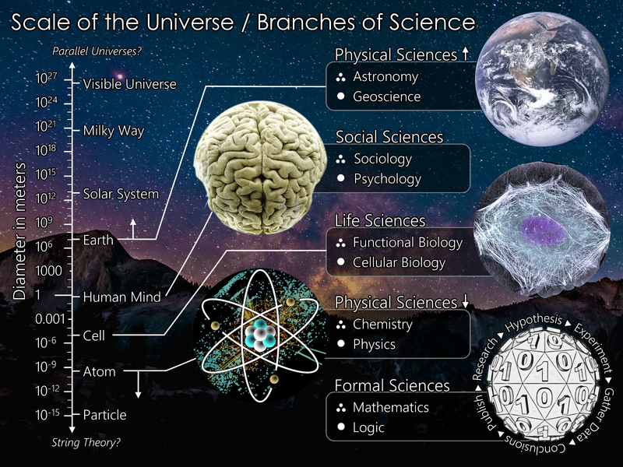
What is science?
Science is a systematic way to tell the story of what you observe about the universe
Fact. Not Opinion or Preferences
Account for all observations
Can predict
Doesn’t contradict known fact

Slide 4
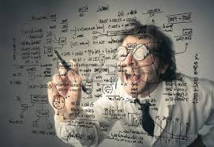
What is the scientific method?
1. Observation
2. Question
4. Prediction
6. Iterate
3. Hypothesis
5. Test
Data science is rooted in the scientific method

Slide 5
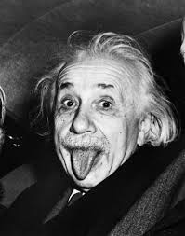

What is a data scientist?
One who uses the scientific method to extract meaning (tell a story) from large quantities of data

Slide 6
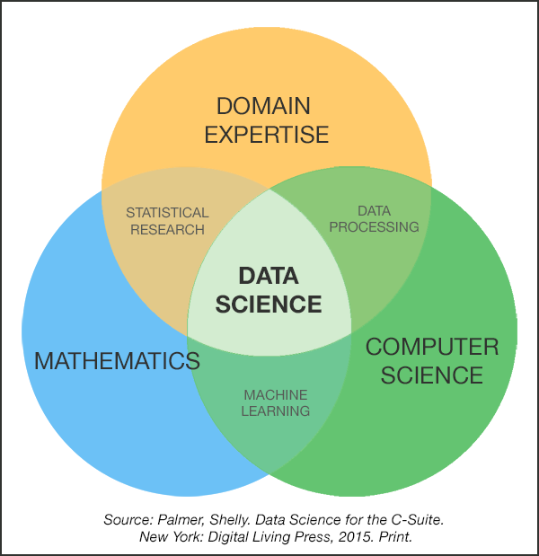
What is Data Science?
Data science (or data-driven science), is an interdisciplinary field of methods, processes, algorithms and systems to extract knowledge or insights from data in various forms, either structured or unstructured.
Business Intelligence
Statistics
Data(base) Management
Visualization
Machine Learning
Data Mining
Artificial Intelligence
Big Data

Slide 7
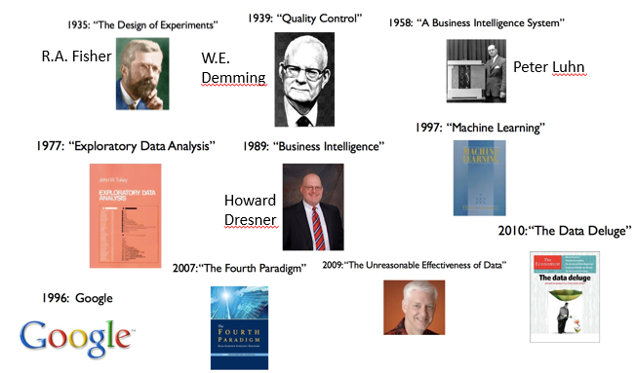
History of Data Science

Slide 8
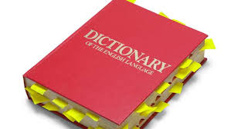
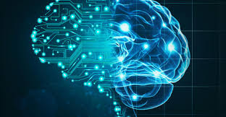
What is Artificial Intelligence?
“the theory and development of computer systems able to perform tasks that normally require human intelligence, such as visual perception, speech recognition, decision-making, and translation between languages.”
-dictionary.com
The term “artificial intelligence” came to inception in 1956 by a group of researchers including Allen Newell and Herbert A. Simon
Notes:
The tool dtaarobot is not a good tool for anything but decision making

Slide 9

What is Machine Learning?
“the scientific study of algorithms and statistical models that computer systems use to perform a specific task without using explicit instructions, relying on patterns and inference instead. “ - wikipedia
Relies on math models
Built from data
Subset of AI
“Machine learning is the study of computer algorithms that allow computer programs to automatically improve through experience.”
- Tom M. Mitchell, computer scientist and machine learning pioneer

Slide 10
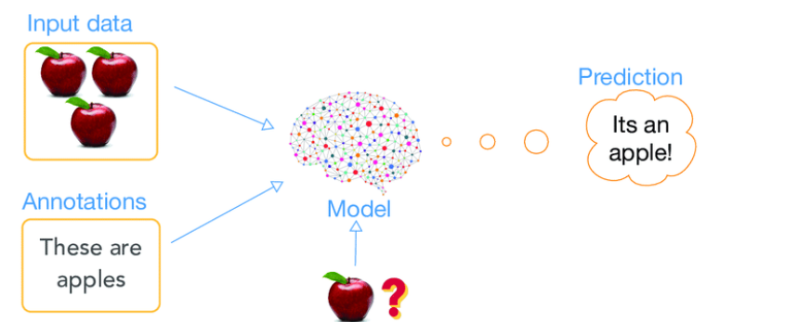
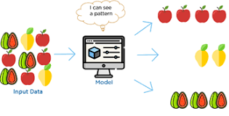
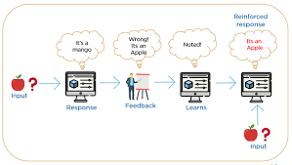
What are the types of Machine Learning?
Supervised Learning
Algorithm with a target variable that is predicted from a given set of predictors – generates function that maps inputs to desired outputs
2. Unsupervised Learning
Algorithm with no target variable to predict – clusters population into different groups
3. Reinforcement Learning
Algorithm where machine is trained to make specific decisions and learns through trial and error.
Notes:
Structrued data

Slide 11
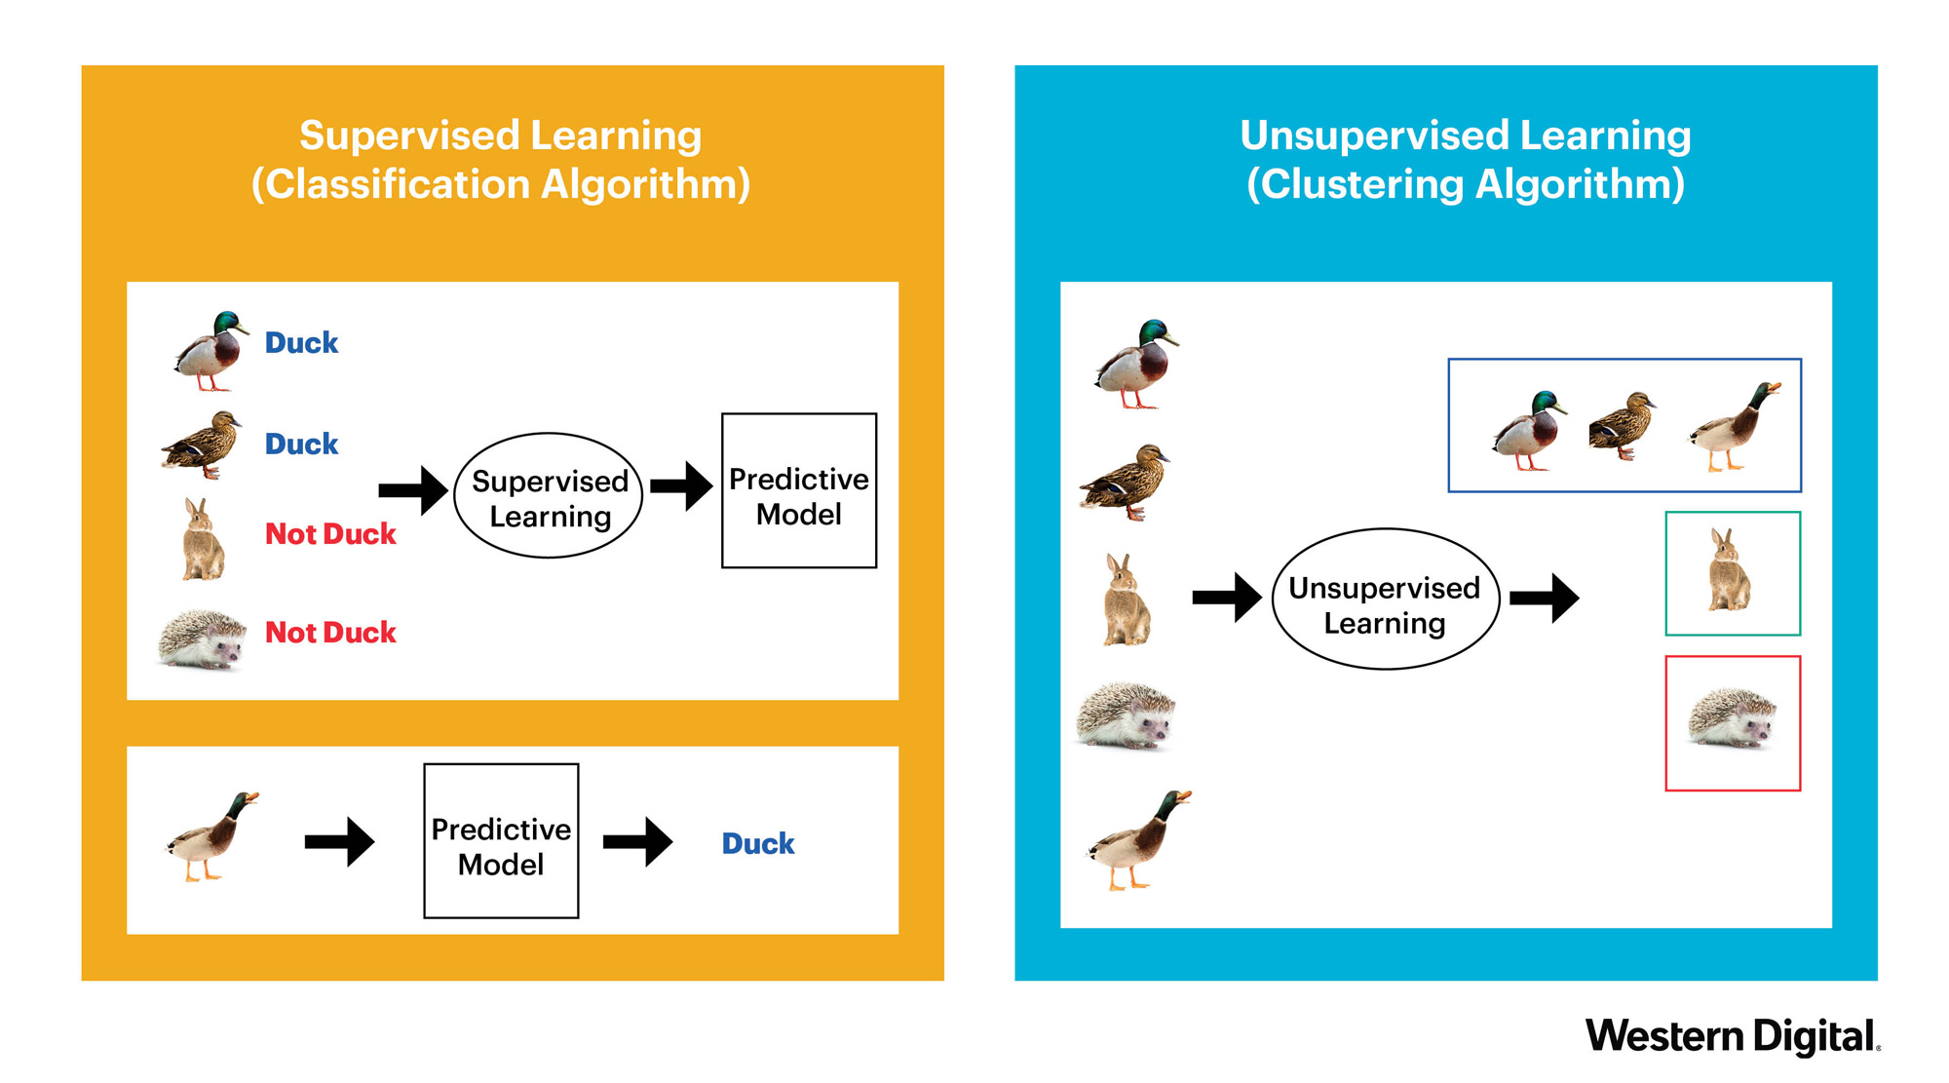
Supervised vs. unsupervised?

Slide 12
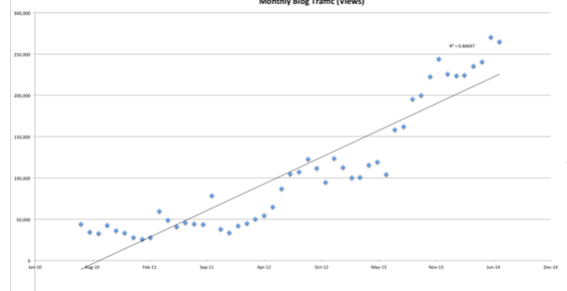
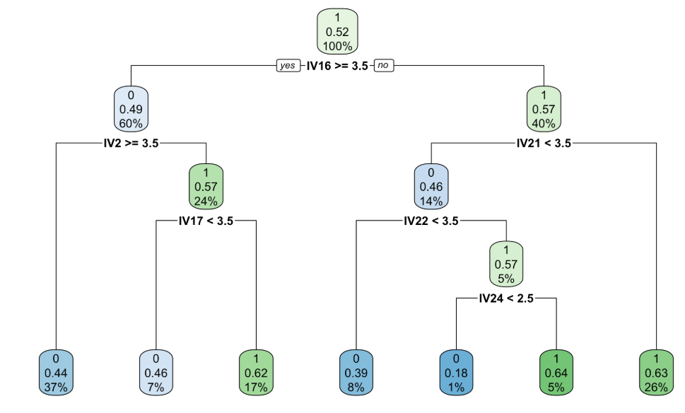
What are some major types of Supervised Learning?
Regression Analysis
Classification Analysis
Fits the data
Linear regression
Logistic regression
Polynomial regression
Lasso/elastic regression
Separates the data
Decision Trees
Random Forest
K Nearest Neighbors
Support Vector Machine
Notes:
Two main categories

Slide 13

Defining an algorithm
“a process or set of rules to be followed in calculations or other problem-solving operations, especially by a computer.” - dictionary.com
“In mathematics and computer science, an algorithm is a set of instructions, typically to solve a class of problems or perform a computation. Algorithms are unambiguous specifications for performing calculation, data processing, automated reasoning, and other tasks.” - Wikipedia
Algorithms are instructions on how to solve a problem

Slide 14
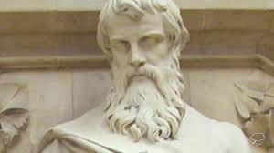
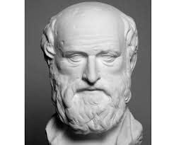
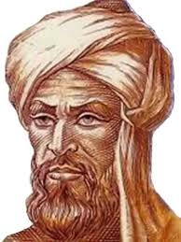
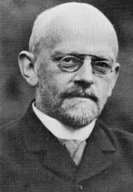
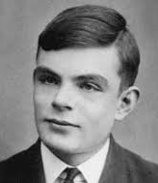
History of algorithms
Euclid (c. 350-250 BC)
Greek mathematician who used an Algorithm to find Greatest Common Divisor – founder of geometry
Eratosthenes (276-196 BC)
Greek mathematician who used an Algorithm to find prime numbers
Muhammad ibn Mūsā al-Khwārizmī ( c. 780 – c. 850)
Founder of algebra - algorithmi is Latinized version of his name
"Good, he did not have enough imagination to become a mathematician“
– Hilbert when he learned a student dropped out to study poetry
David Hilbert (1862-1943)
Partial formulation of the modern concept of algorithm
Alan Turing (1912-1954)
formalization of the concepts of algorithm

Slide 15

Why are algorithms important for AI/ML?
Machine Learning uses algorithms for models
Statistical sets of instructions on how to predict
Some algorithms can then improve over time
Input: Data
AI/ML Algorithm
Output: Predictions

Slide 16
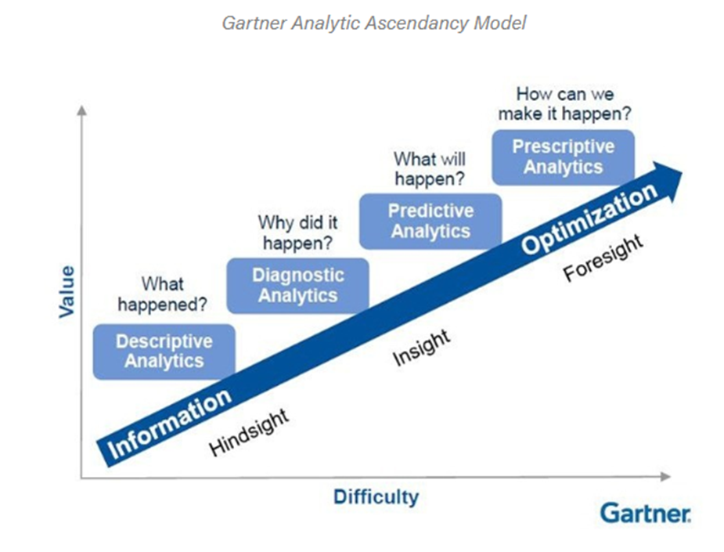
Determine how to answer the problem

Slide 17

When should you not use AI/ML?
You don’t have enough data – risk of bias
You have “noisy” or messy data - irrelevant information can cause the data to memorize noise
You have incomplete data – need to have a plan to impute or leave out
You are in a hurry
You have a simple problem to solve

Slide 18
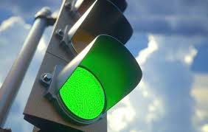
When should you use AI/ML?
You cannot code the rules
You have a large-scale problem
You have a lot of clean, labelled data
You want to find a pattern to predict outcomes or relationships

Slide 19
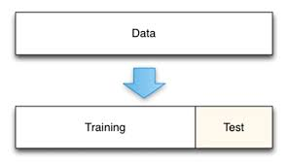
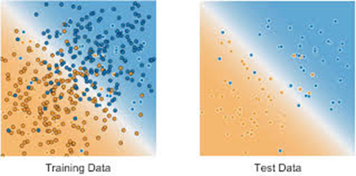
Step 1: Select Training vs. Test Data
Separate data into 2 chunks
Training data used to fit the model
Test data used to validate the model
70%
30%
This helps eliminate bias and overfitting

Slide 20
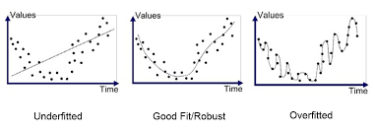
What is Overfitting?
“An analysis that corresponds too closely or exactly to a particular set of data, and may therefore fail to fit additional data or predict future observations reliably".
Matching the exact data points – not the characteristics of the data

Slide 21
Step 2: Build the model
Create training data
Input training data
Produce Model
Choose algorithm

Slide 22
Step 3: Validate and tune the model
Create training data
Input training data
Produce Model
Choose algorithm
Input test data
Validate Model
Tune Model
Deploy Model

Slide 23
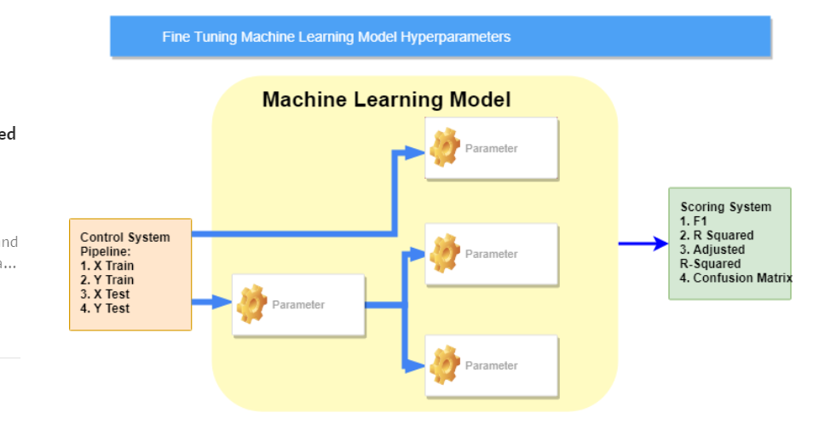
What is tuning?
Adjusting certain parameters of the algorithm to gain the greatest accuracy

